Slide 1
TODAY’S PLAN
Discuss the movie, Outsourced.
Recap of some of the terms we use when analysing texts and films
Rewatch some of the scenes in the movie
Group discussion task about cultural clashes
Classroom discussion about the ending
Individual writing task concerning the message(s) conveyed in the movie.
Group discussion task.

Slide 2
OUTSOURCED
A movie about cultural differences, directed by John Jeffcoat
Notes:
Today we are going to talk about the movie we watched on Monday.
We are going to og through it bit by bit.
And we are going to have our analytical glasses on.
You took some notes on Monday and it might come in handy to you to find them and have them in front of you when we talk and discuss.
We will talk about setting, plot and characters, before we move on to the main themes.
We will do a few discussionstasks and I do hope you’ll engage in a good classromdiscusson.
Please let me know if I am moving to fast, being unclear, or if I am using complecated words.
This is a learingsession for me as much as it is for you.

Slide 3
Analysing film
Setting
Where and when
Plot
The events that make up the action in the story.
Characters
Protagonist, antagonist and minor characters
Theme(s)
The central idea(s) in the movie. What the story is really about
Message(s)
What the director wants to convey
Techniques
Visual and sound effects
Music
Use of camera and clipping
Targets p. 70-71

Slide 4
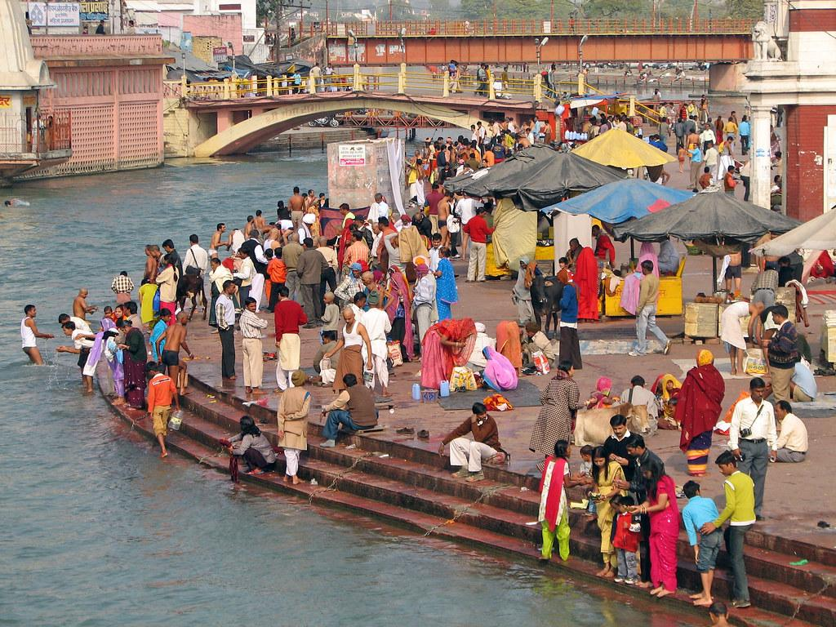
SETTING
USA
INDIA
THE BEGINNING OF THE 21st CENTURY
Notes:
The movie is set in USA and India.
How do you think the director presented the two different countries in the beginning of the movie?
Which tools or techniques did he use to show the differences.
Did you notice anything particular about the colours? And what about the music?

Slide 5
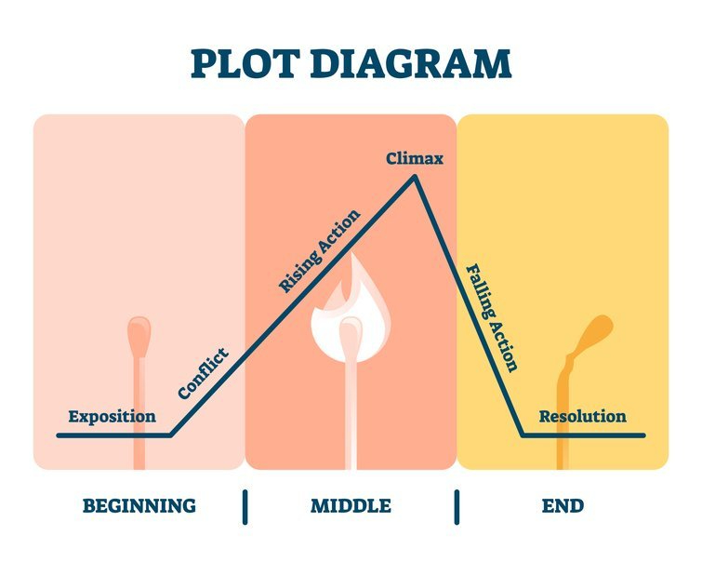
Todd is an office manager in a callcenter in the US
The office is being outsourced and Todd is sent to India to kickstart the salesteam and train his own replacement.
Todd has a hard time understanding Indian culture and he experiences many difficulties at the office
Holi – the turningpoint
Todd is adapting to Indian culture and is finally listening to his Indian co-workers. He falls in love with Asha
Todds boss arrives and tells him that the callcenter is being outsourced to China
Todd goes back to America
Puro goes to China
Asha calls

Slide 6
CHARACTERS
Protagonist
Antagonist
Minor characters
Static and dynamic characters
Notes:
Static characters doesnt undergo change. Like Donald Duck
Dynamic characters undergoes change.
Lets have that in the back of our minds when we discuss the characters
Who is the protagonist in this film?

Slide 7
TODD(MR TOAD)
From ethnocentrim to ethnorelativistim
Increased intercultural competence
Notes:
What can you say about Mr. Todd?
Is Mr Todd a dynamic og static character?
Todd undergoes a transition in the movie. He changes.

Slide 8
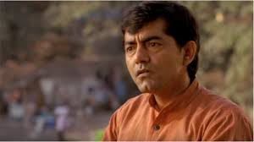
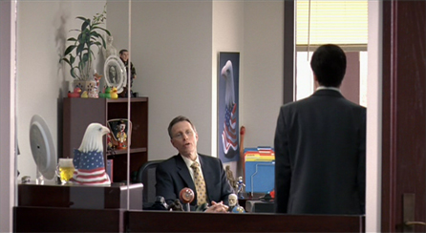
Characters
Asha
Mr. Puro
Dave
Aunt Ji
Boy
Menmeth
Businessman
Notes:
Asha-modern woman, but still comitted to Indian values and traditions.
Dave- is he the antagonist?
Is he a symbol of capitalism and american business culture. Money talks. It is all about the money
Aunt Ji- the manifistation of Indian traditional values.

Slide 9
THEMES
Notes:
The central idea(s) in the movie.
Often abstract- superior to the concrete actions.
Love, hate, grief, power, capitalism, repression, success, forbidden love, cultural differences,

Slide 10
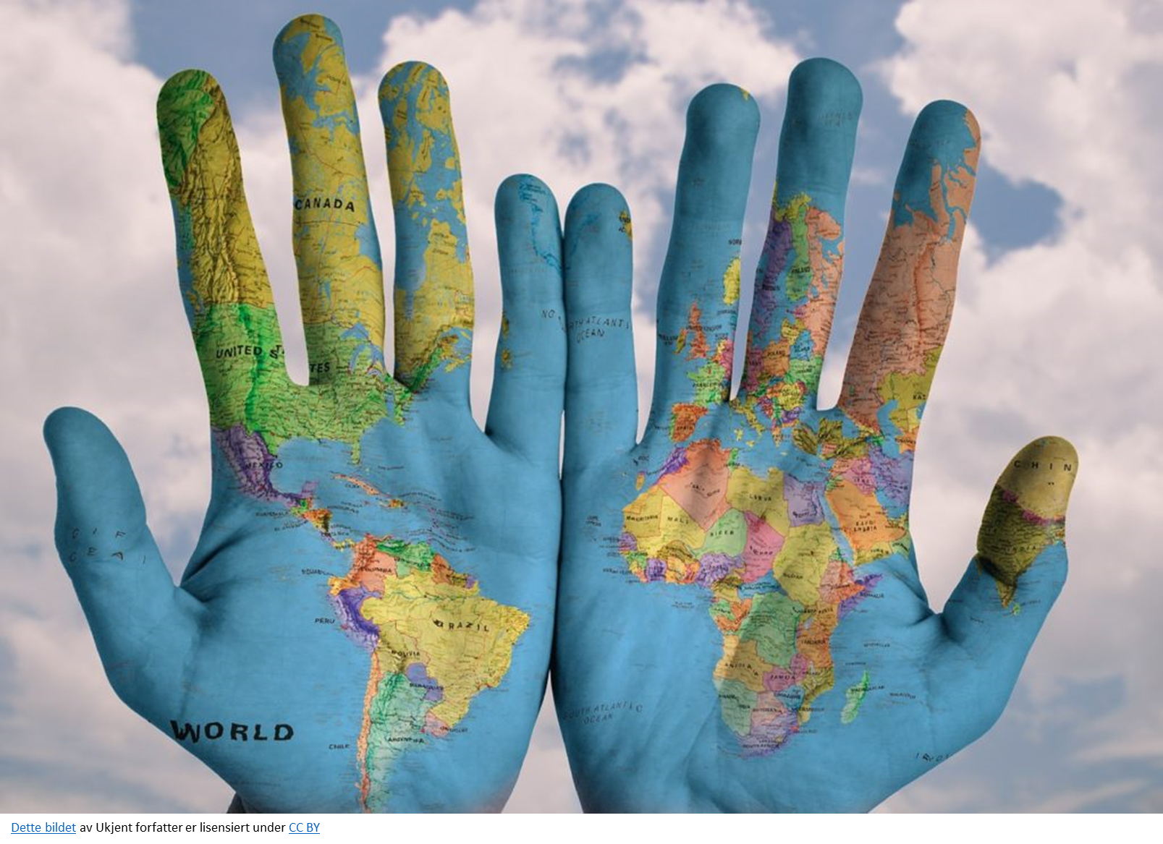
OUTSOURCING AND GLOBALIZATION
OUTSOURCING
GLOBALIZATION
Outsourcing is an agreement in which one company hires another company to be responsible for a planned or existing activity that is or could be done internally. It sometimes involves transferring employees and assets from one firm to another.
Globalization is a term used to describe how trade and technology have made the world into a more connected and interdependent place. Globalization also captures in its scope the economic and social changes that have come about as a result.
Dette bildet av Ukjent forfatter er lisensiert under CC BY-SA
Notes:
How would you feel if you were suddenly told that you had lost your job due to outsourcing? Plenty of companies have chosen to move the production of goods, customer services and/or other tasks to cheaper locations or to other countries, in order to cut costs and make more mone

Slide 11
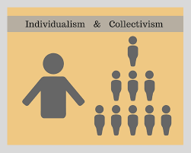
CULTURAL DIFFERENCES
Cultural clashes
Genderroles
Marriagetraditions
Personal space
Businessculture
Language and misunderstandings
USA
INDIA
Individualistic society
Independence and personal freedom
Self-realization
Collectivistic society
Familyoriented
Social obligations
Notes:
Hofsteade collectivistic/individualistic dimension of values

Slide 12
First meeting with Mr Puro
Notes:
Tid: 10.20

Slide 13
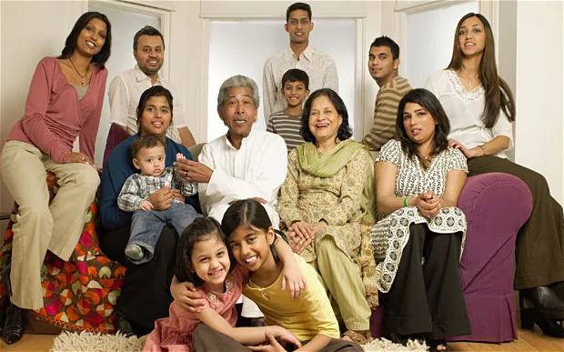
Family values
Notes:
We are going to watch a clip about Aunt Ji who doesn’t understand why he broke up with his girlfriend
You also have the scen wher Mr Puro asks about his parents and why he doesn’t live with them «But why?
Tid: 14.05

Slide 14
Personal Space
Notes:
Her skal klippet når han reiser på toget vises.
Tid: 7.12

Slide 15
Marriage traditions
Notes:
Show a clip where Asha tells Todd that she has been engaged since she was a child
Tid 1.11.

Slide 16
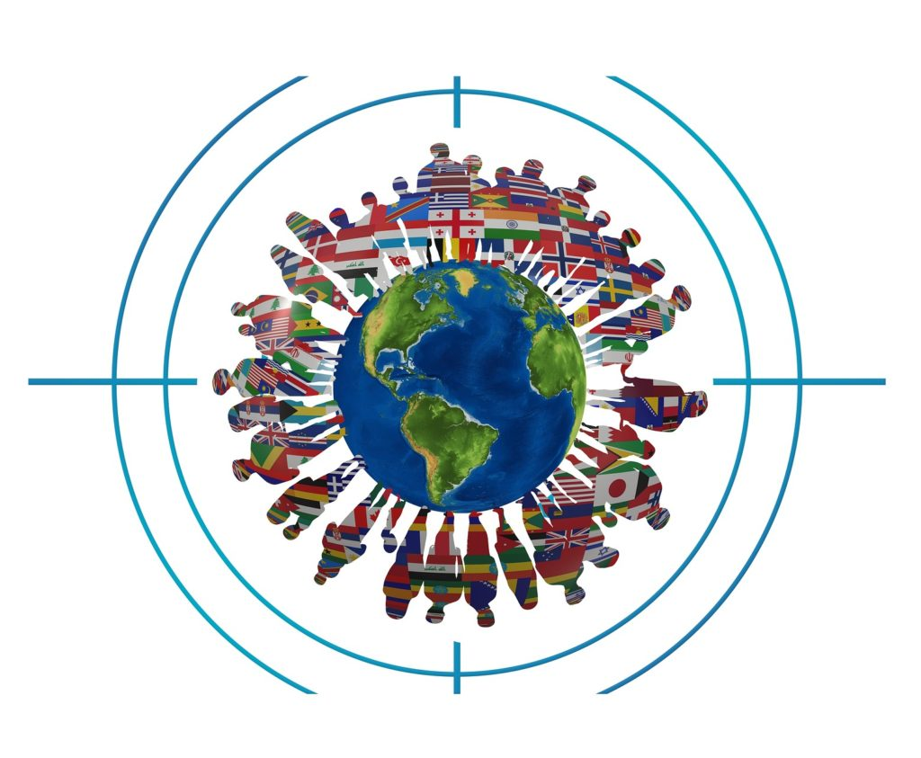
DISCUSSIONTASK
WHAT IS UNIQUE IN YOUR CULTURE?
HAVE YOU EXPERIENCED ANY CULTURAL CLASHES?
WHAT WAS THE BIGGEST CULTURAL SHOCK FOR YOU WHEN YOU CAME TO NORWAY?
Share with the person next to you
Notes:
5- 10 minutes to discuss this.
Ask if someone want to share an experience with everyone.
I can tell something from Hong Kong.

Slide 17
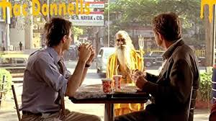
A MINOR TURNINGPOINT
«Just a word of advice.
I used to feel like you did.
I was resisting India.
Ones I gave in, I did much better».
-Businessman at Mac Donnells-

Slide 18
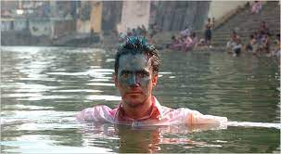
THE TURNINGPOINT
Notes:
The climax, the turningpoint
Tid i filmen: 41.50
Baptism is a form of ritual purification—a characteristic of many religions throughout time and geography.
Christian sacrament marked by ritual use of water and admitting the recipient to the Christian community
An allusion- referring to something famous/known in real life or literature.

Slide 19
Language and misconceptions
You Schmuck
Don’t break both legs
Menmeth- manmeat
Chicago
Internet
Different englishes
Notes:
Filmclip- break a leg

Slide 20
Has Todd brought home something from the Indian culture?
FULFILMENT
Notes:
Picture of the symbols he brought home to US
The bindi is said to retain energy and strengthen The metaphorical third eye which when opened has the power to see clearly through the illusions seen by the physical two eyes.
He has brought home a sign
And he calls his mum to let her know he is coming home

Slide 21
OPEN ENDING
Who called Todd?
What do you think happenes next?

Slide 22
Discussiontask Messages
Does the movie have a clear message?
What do you think the director is trying to convey?
10 minutes: Individual writing task: Write down four things you have learned from the movie. (10 minutes)
15 minutes to discuss your opinions in groups of 4. You should agree upon 4 things to share with the rest of the class

